Slide 1
TaikaGAN: Two-Domain Image-to-image Translation for Anime-styled Illustrations
Bautista, Domingo, Tan

Slide 2
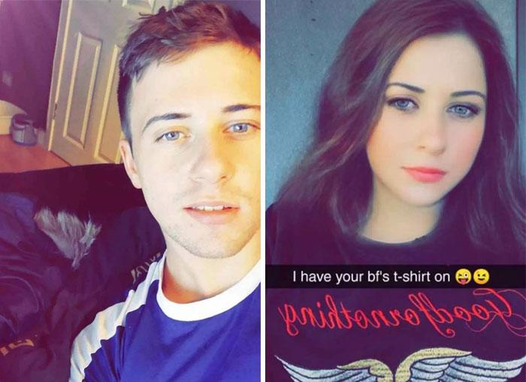
Motivation
Messaging app Snapchat has a filter that enables users to see a gender-swapped version of themselves.

Slide 3
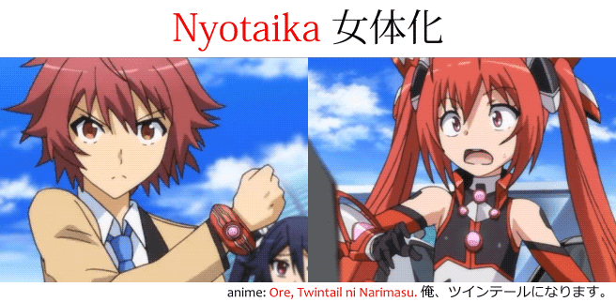
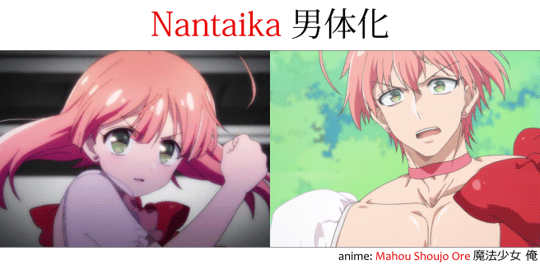
Challenge
What if it can be done to anime characters?

Slide 4


Ideally, this is what happens.
However, obtaining paired data is impractical.
Source: プリズム☆ま～じカル PRISM Generations！

Slide 5
Dataset
Raw images are obtained from visual novel site Getchu¹
Images are then manually sorted according to gender, with some quality control enforced
Sorted images are cropped via a face detector for anime/manga², and then scaled to
Badly cropped images are removed
Image count:
Male x,xxx
Female x,xxx
¹http://www.getchu.com
²https://github.com/nagadomi/lbpcascade_animeface

Slide 6
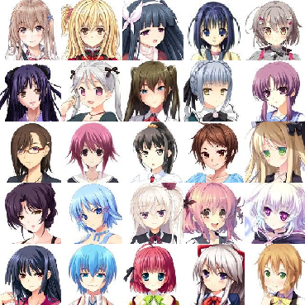
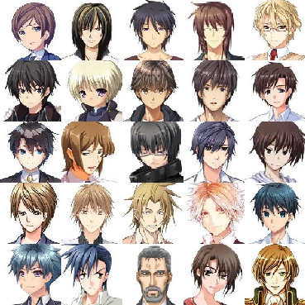
Dataset
Sample of female faces
Sample of male faces

Slide 7
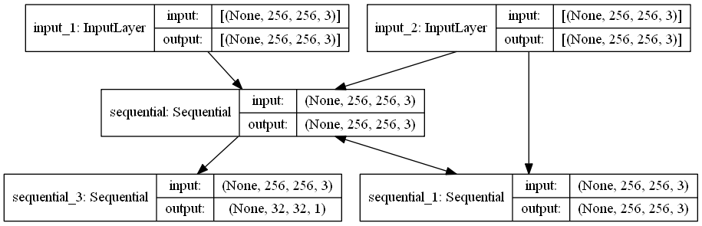
Top-level Architecture

Slide 8
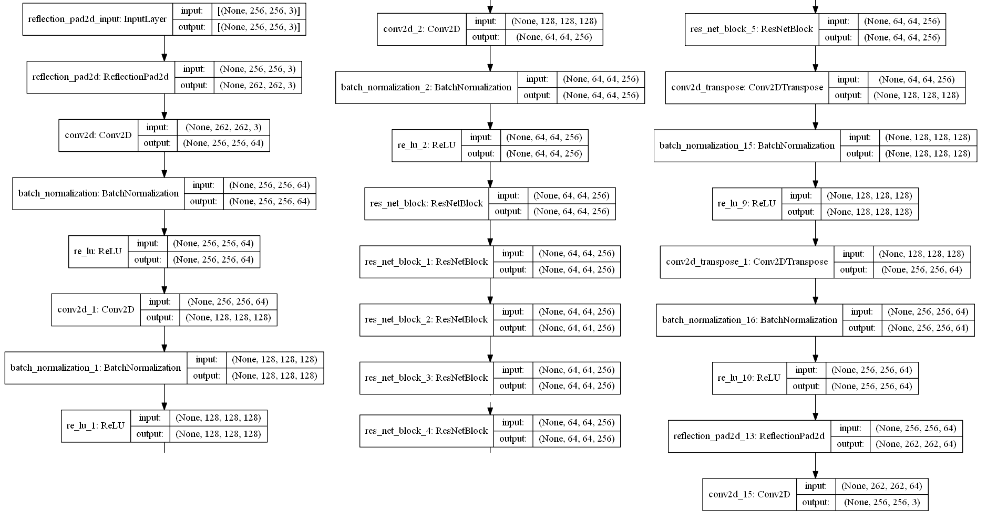
Generator

Slide 9
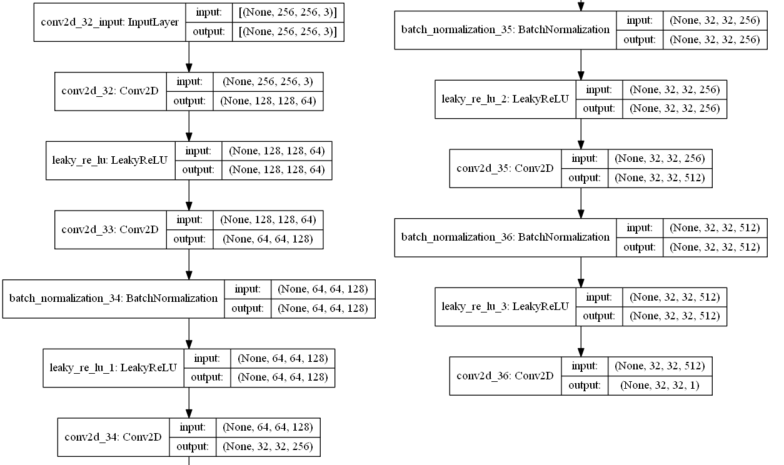
Discriminator

Slide 10
Results

